Slide 1
Everyone Plays
Collaborative Data Science Using Apache Zeppelin

Slide 2
Preamble
This presentation is meant to be given in Notebook form inside Zeppelin.
The actual notebooks are available at
https://github.com/rawkintrevo/apachecon
Along with instructions for importing them into Zeppelin.
It’s good to have some slides of screen shots though for if/when my Notebook goes off the rails due to something out of anyone’s control.
SO…..

Slide 3
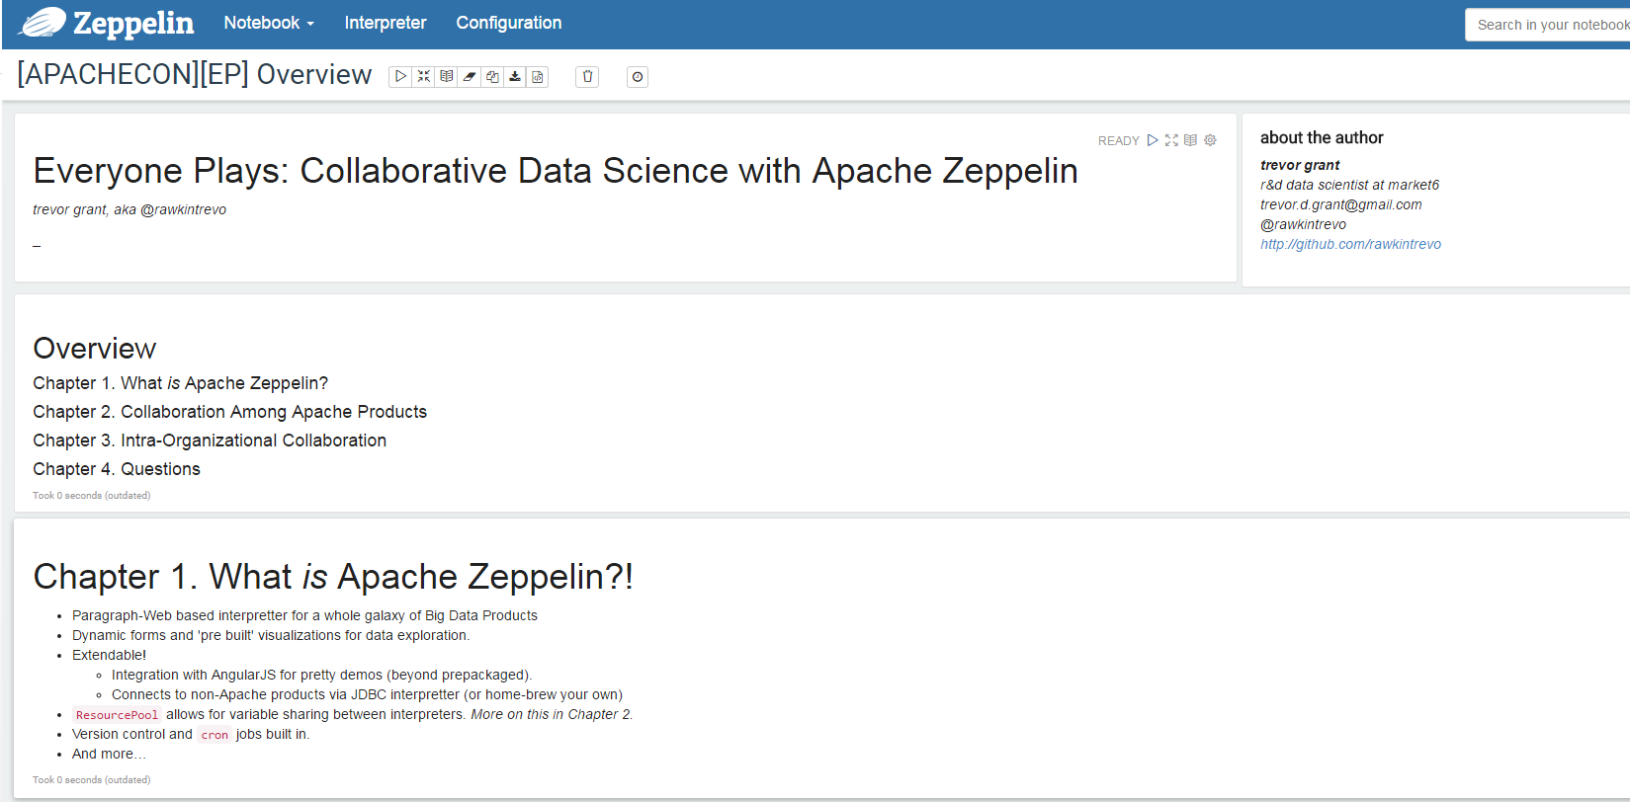

Slide 4
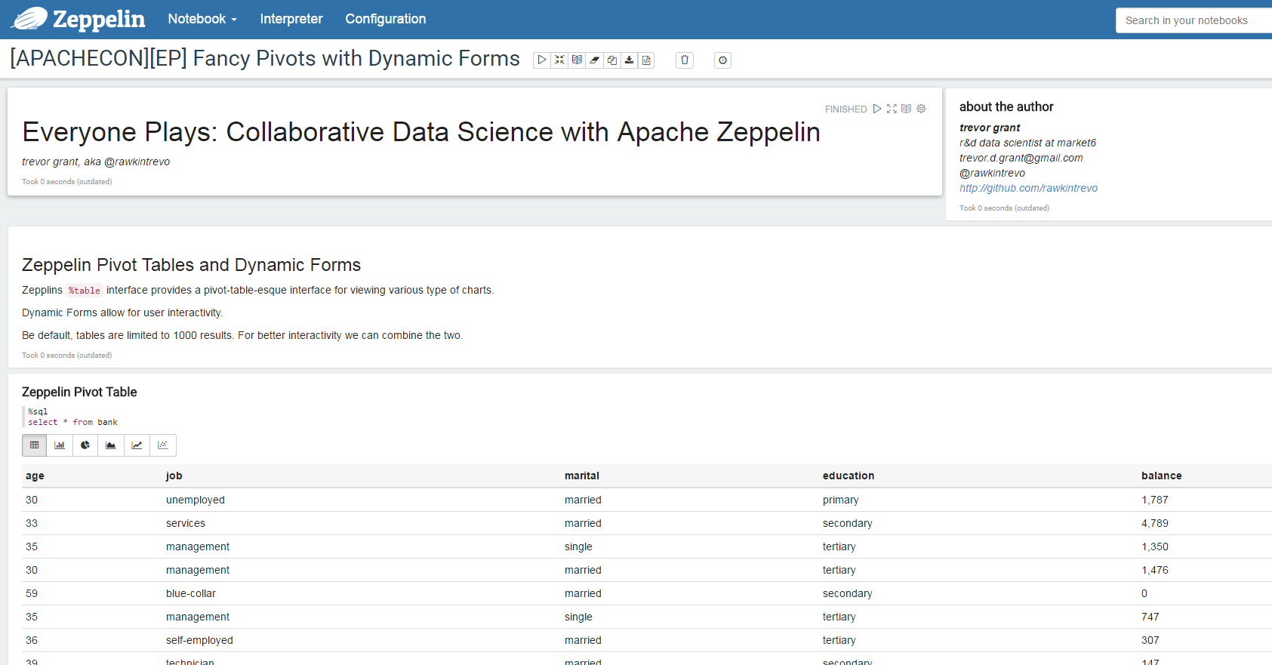

Slide 5
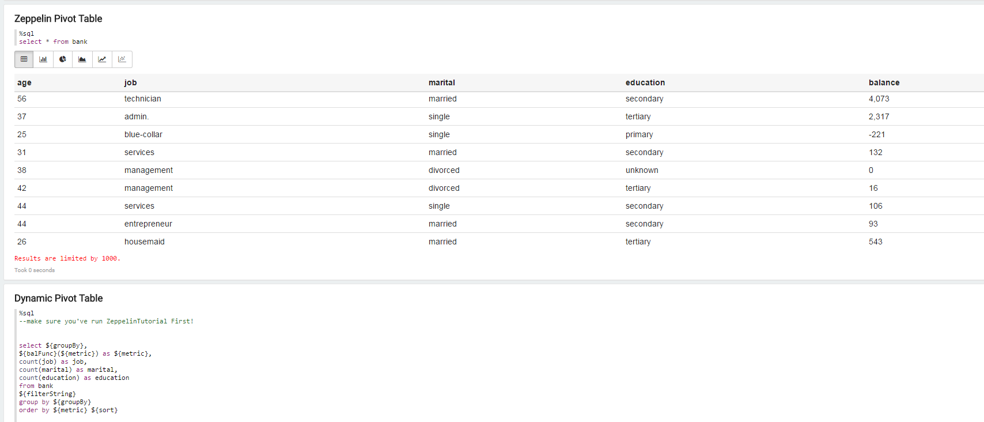

Slide 6
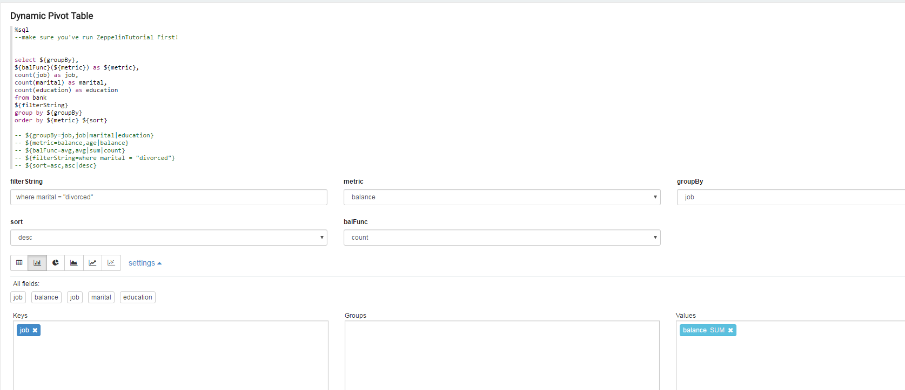

Slide 7
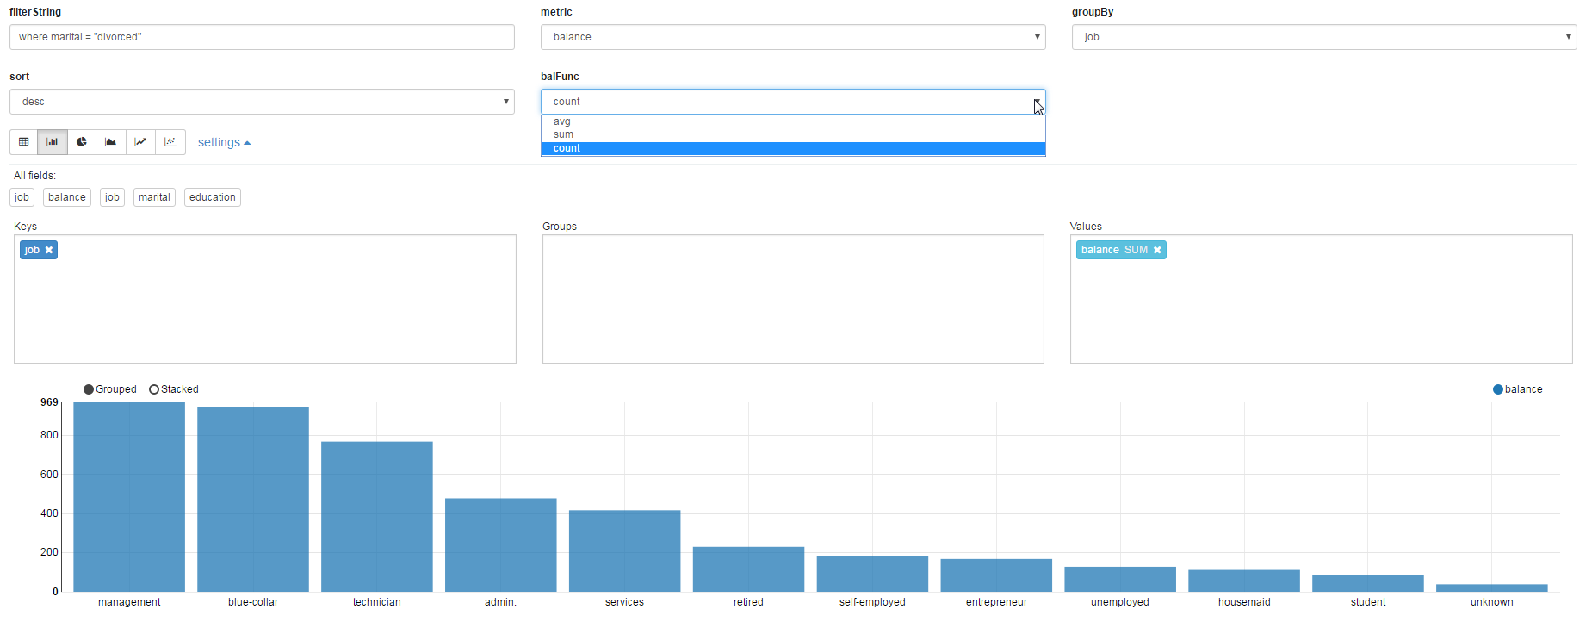

Slide 8
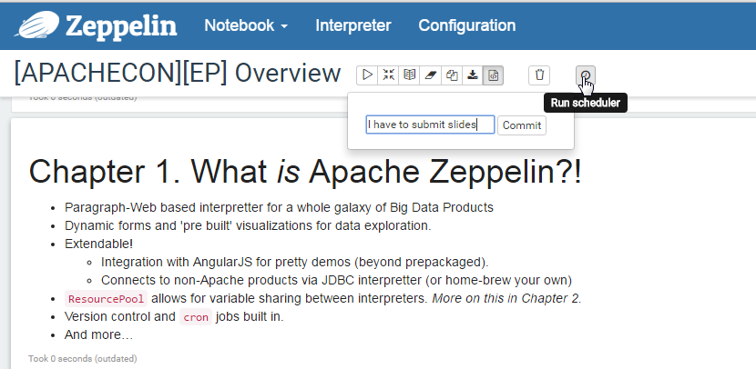

Slide 9
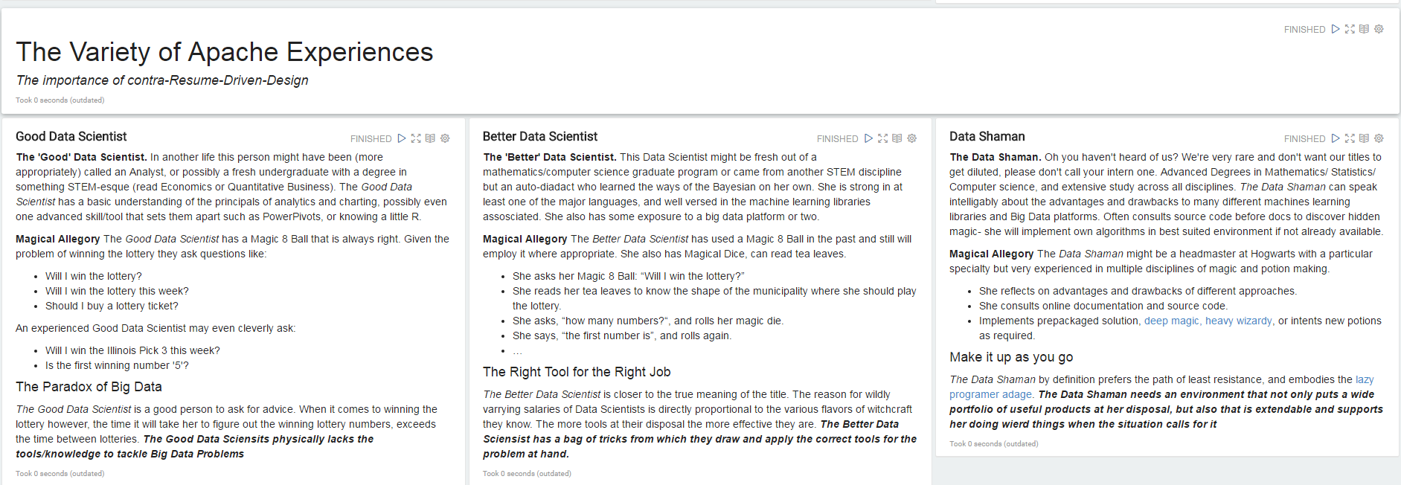
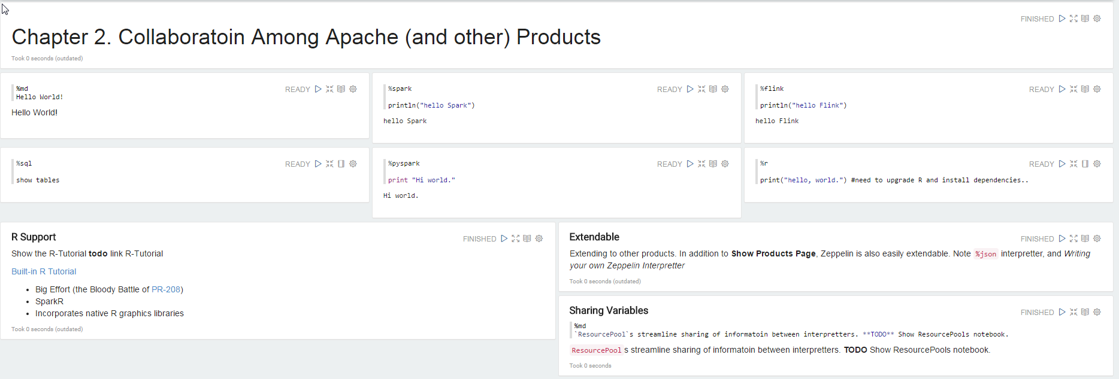

Slide 10
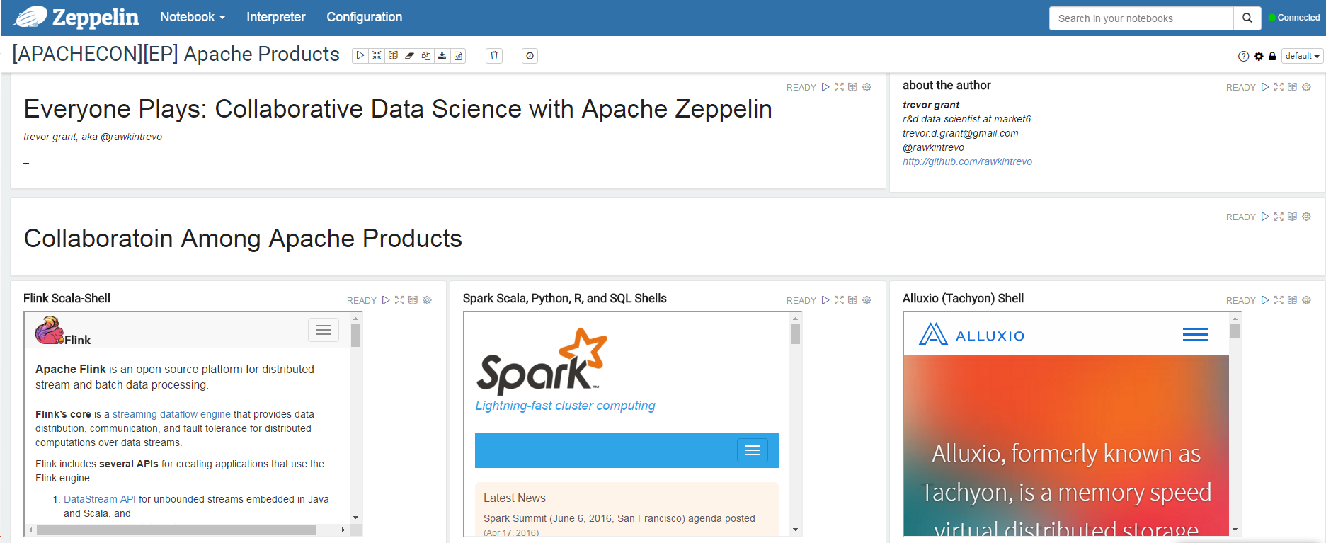

Slide 11
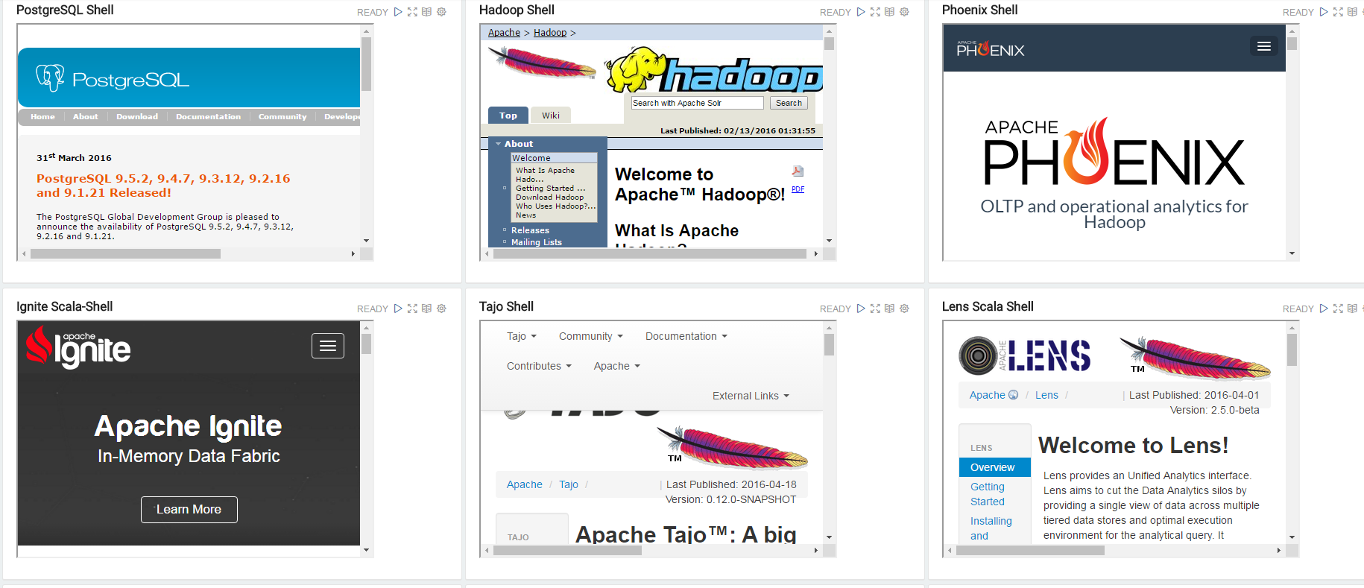

Slide 12
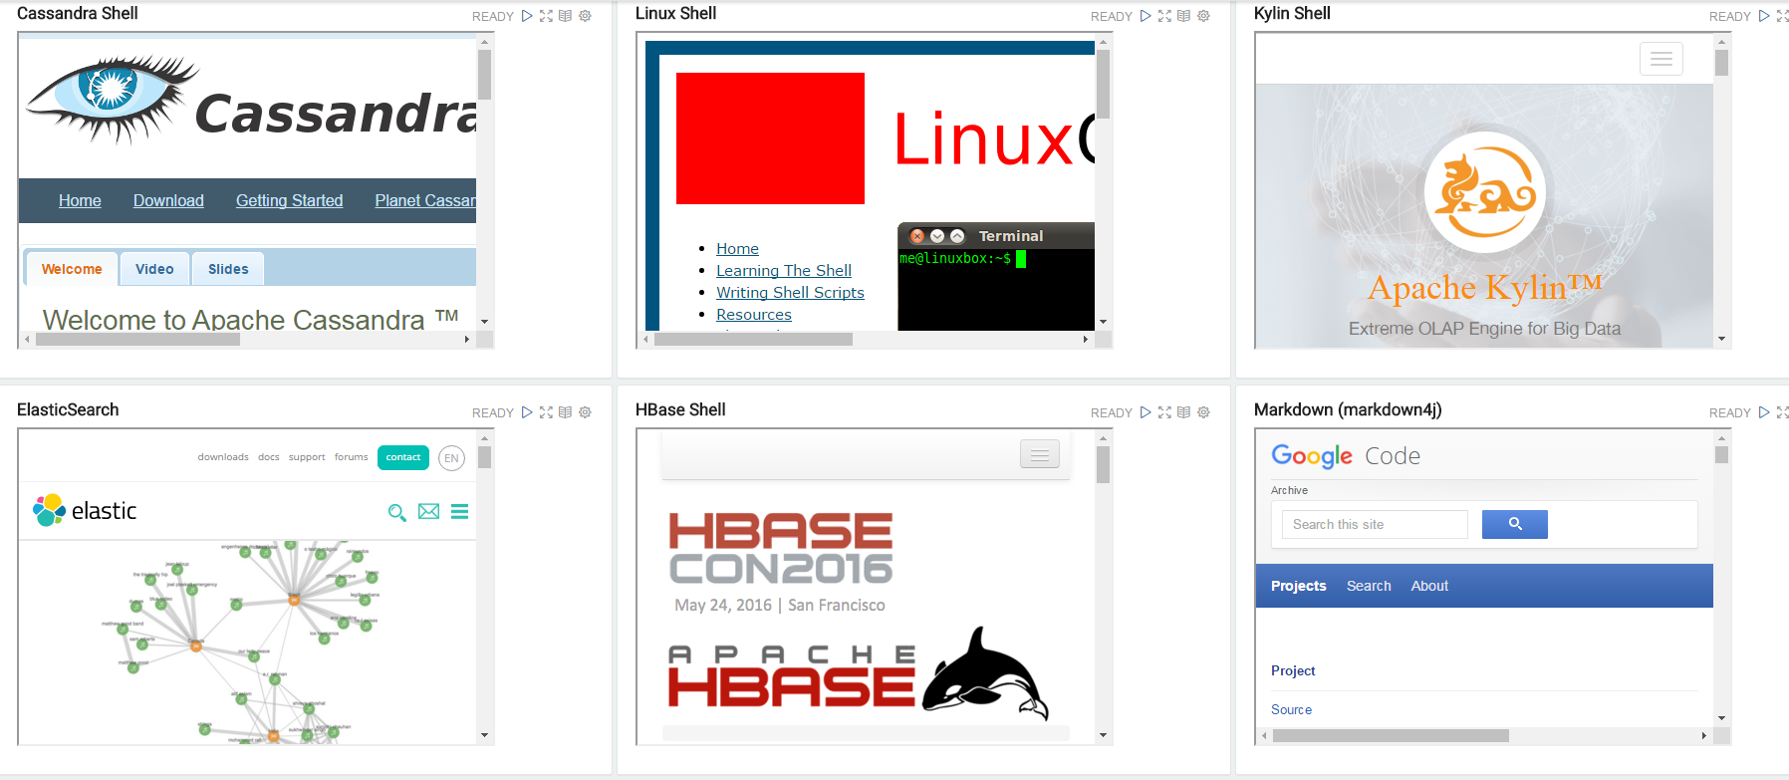

Slide 13


Slide 14
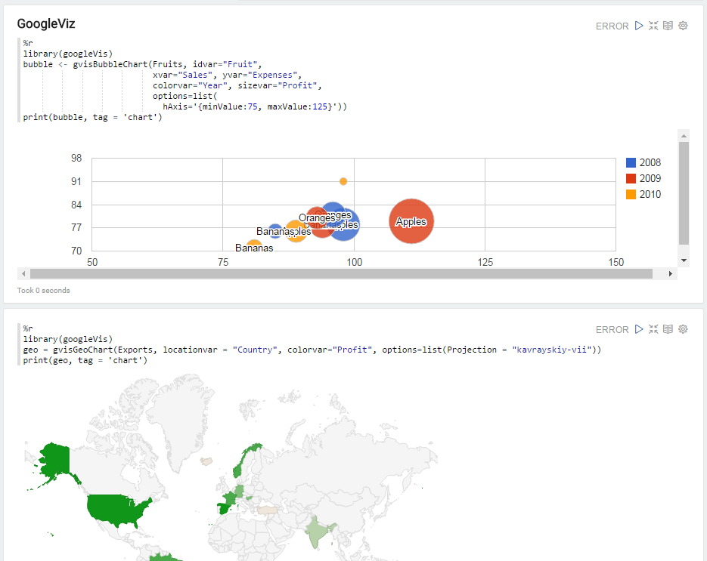

Slide 15
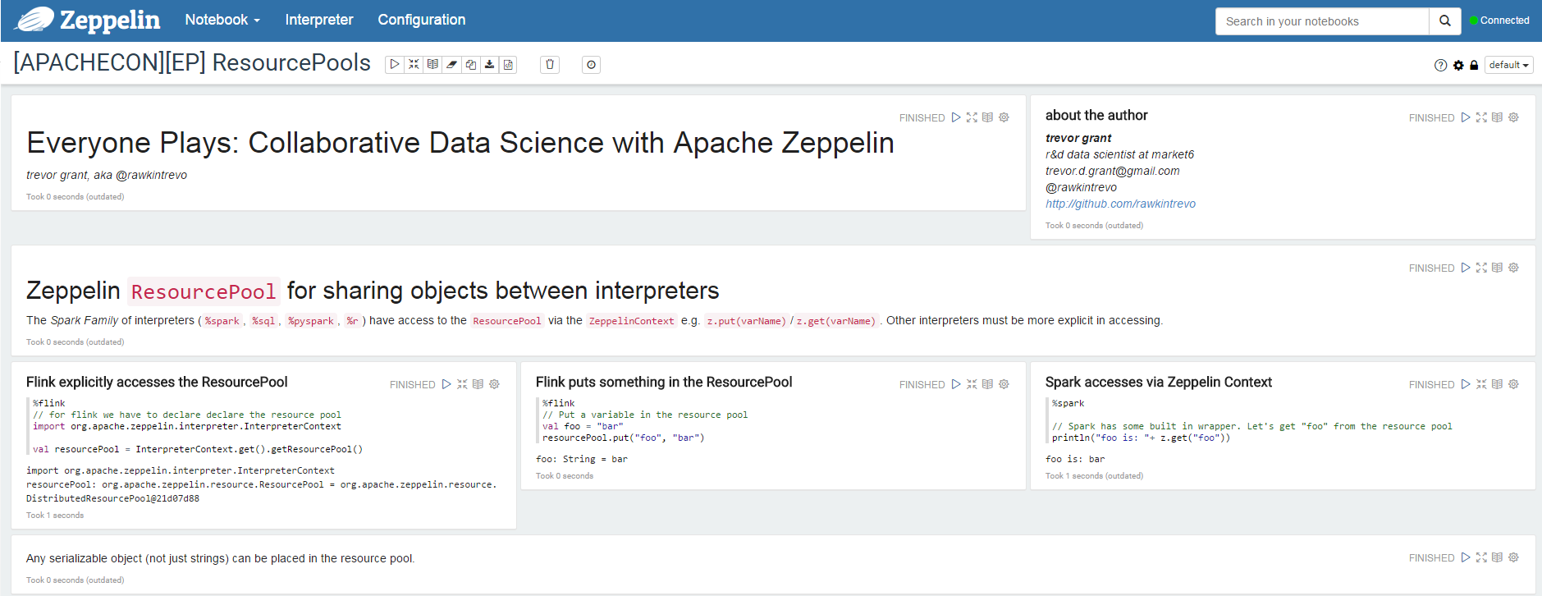

Slide 16


Slide 17
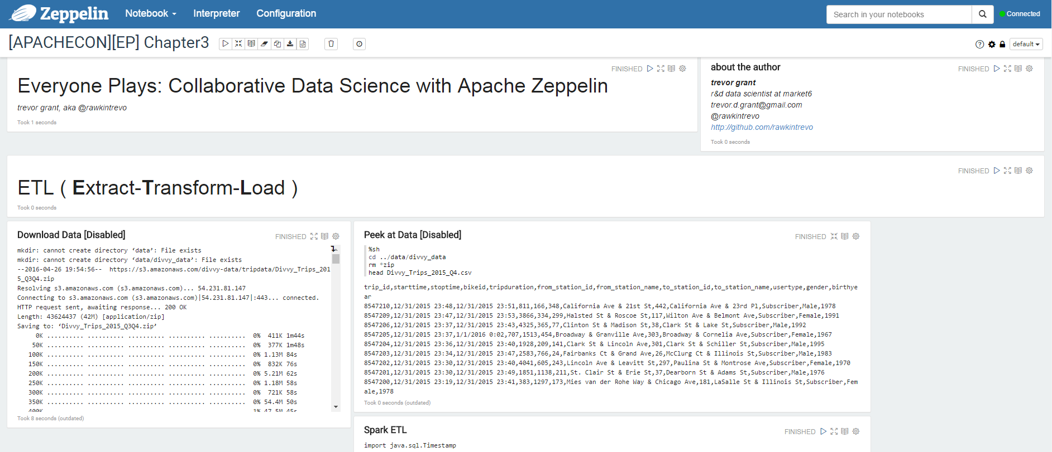

Slide 18
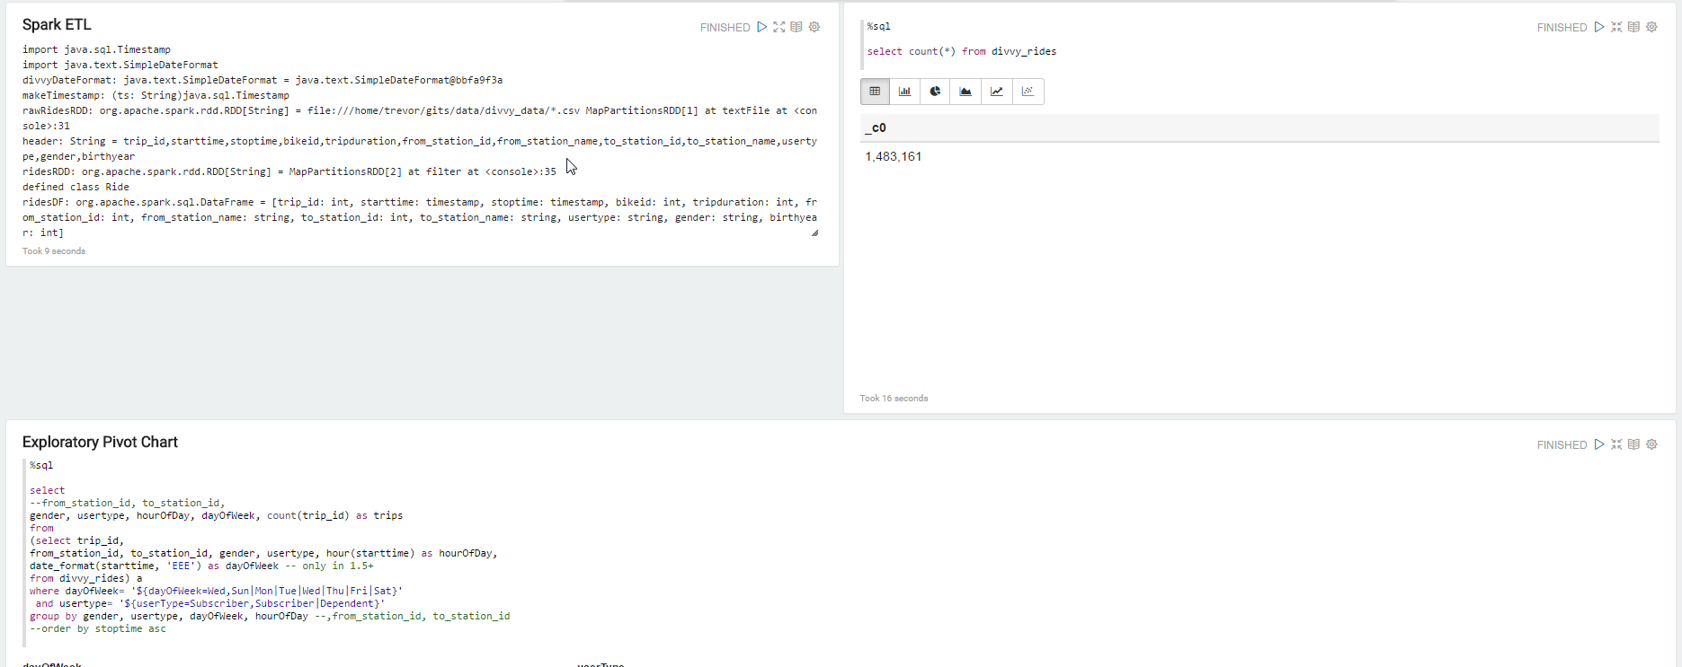

Slide 19
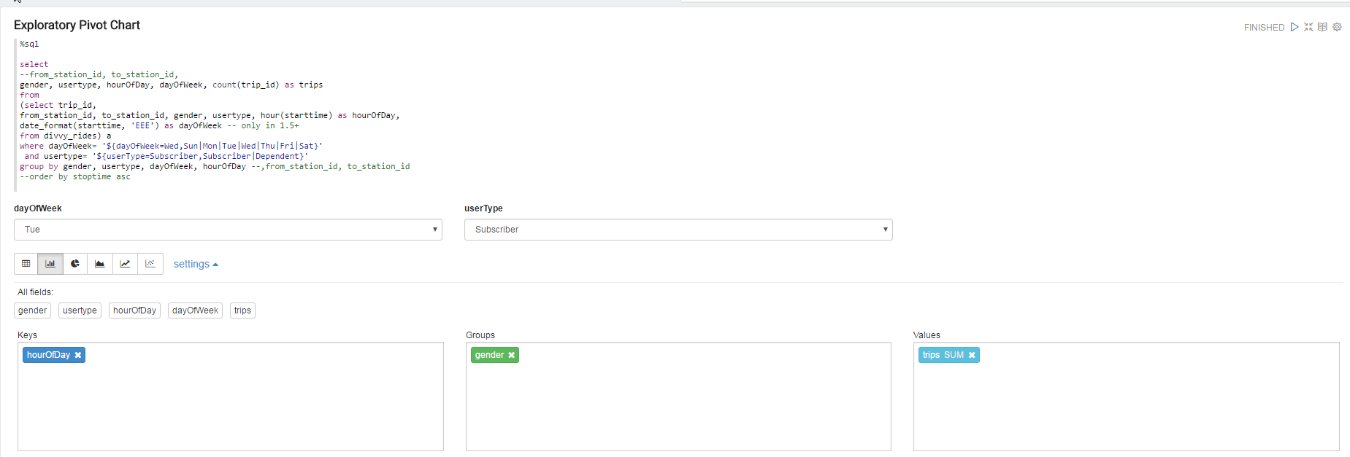

Slide 20
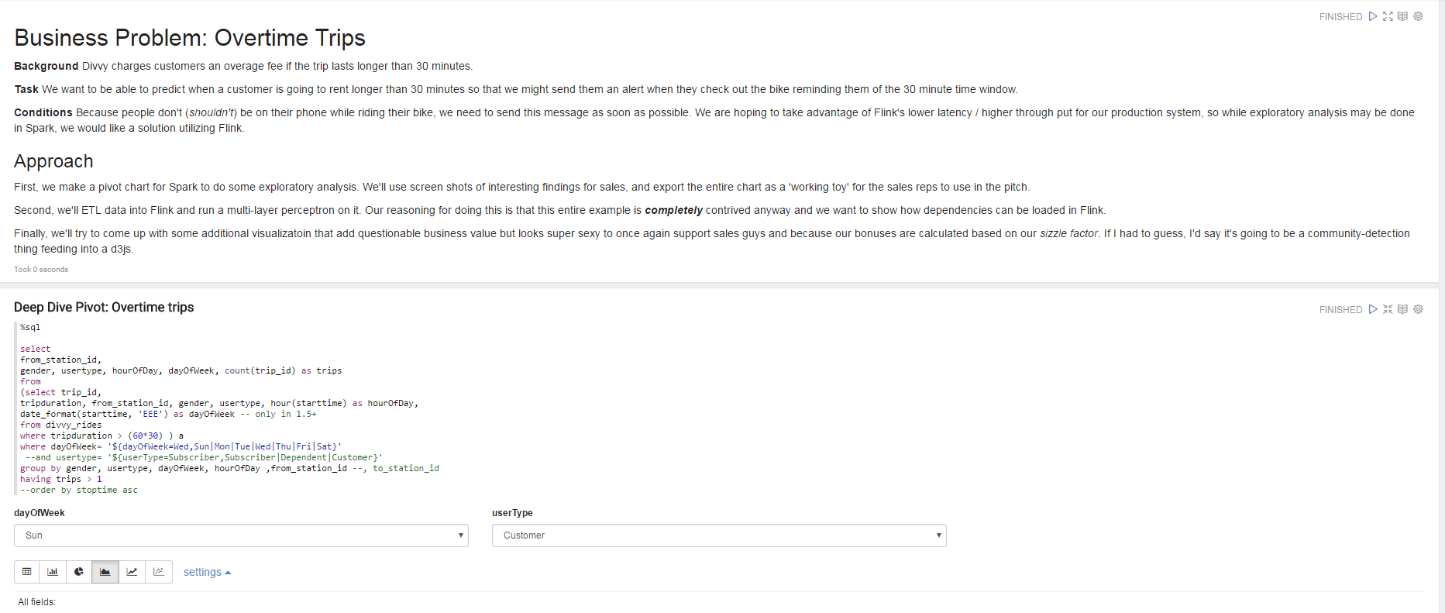

Slide 21
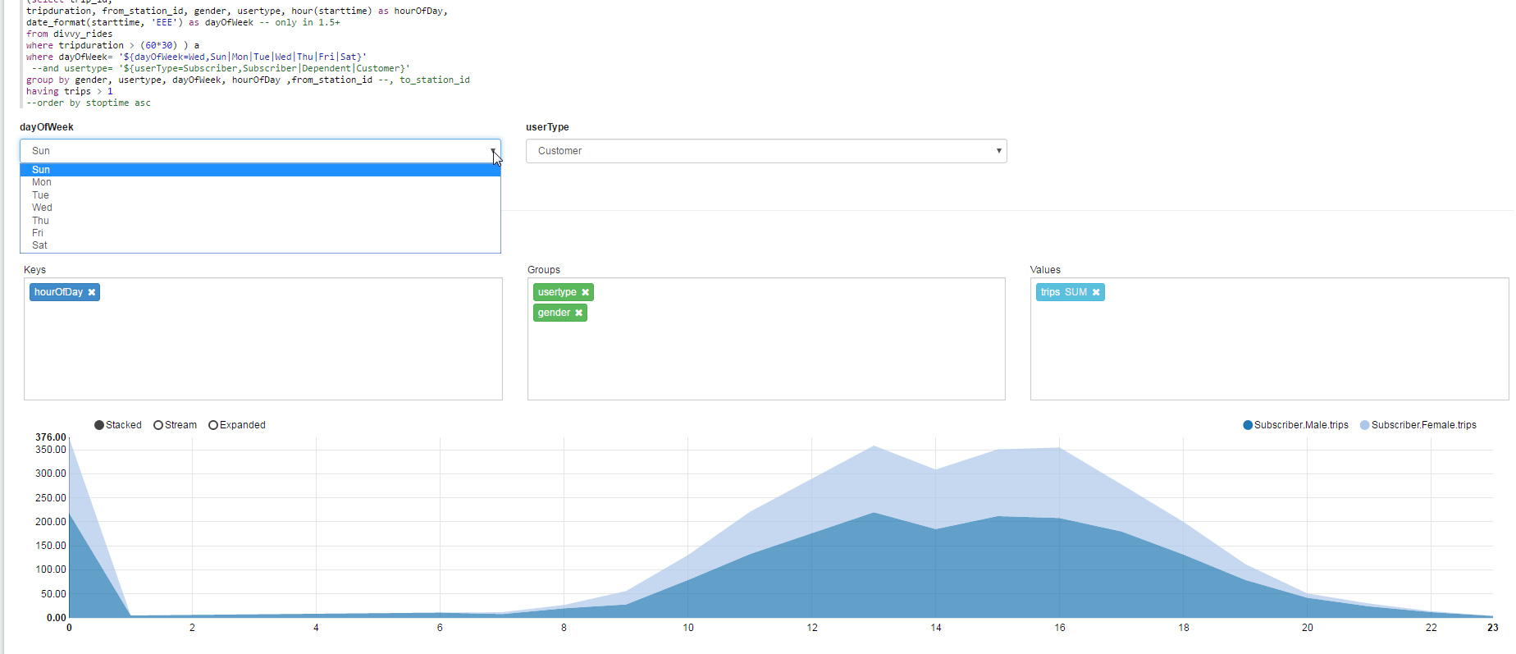

Slide 22
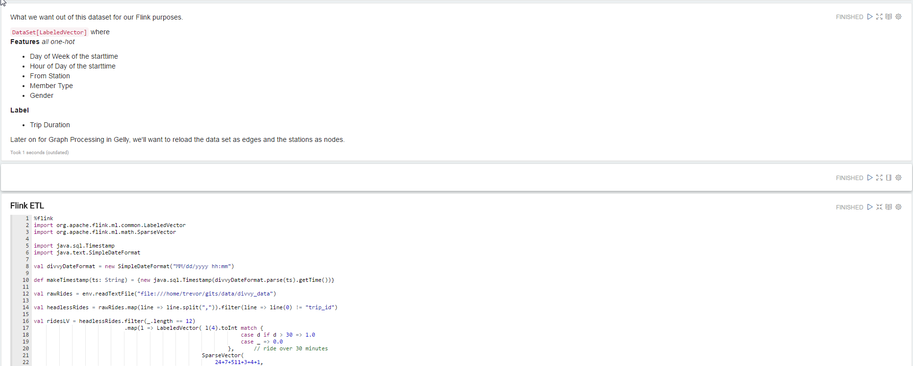

Slide 23
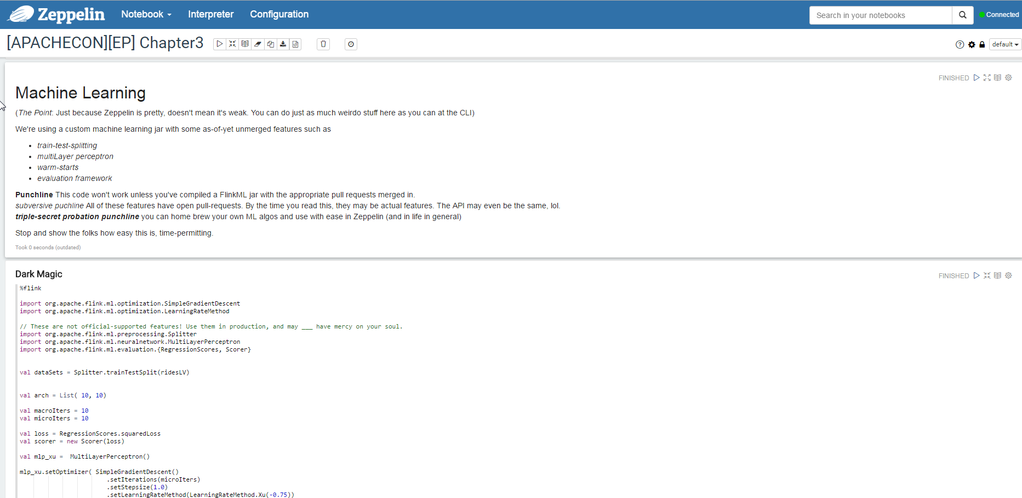

Slide 24


Slide 25
Questions?

